Slide 1
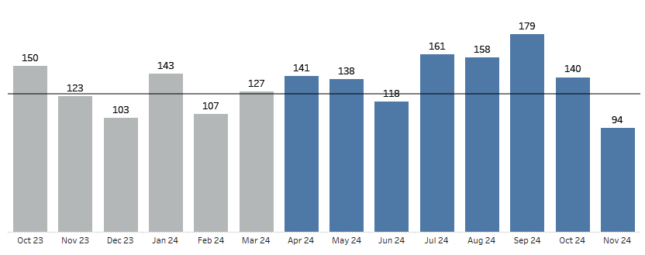
MPB Acute Secondary Dashboard | Reference Info
Objective
Dashboard compares targets to FY25 performance for base MPB customers managed by Secondary Sales Reps to observe if there is growth within existing territories
Metrics
FY25 Targets: Monthly average of Net Sales/Gross Profit actuals during the second half of FY24
FY25 Actuals: Net Sales refreshes daily; finalized Gross Profit become available around 25th of the next month
FYTD Summary: Net Sales/Gross Profit includes actuals from April 2024 through the most recent completed month
Ranking: sort by delta (actuals – targets)
Data Source
Refreshes Daily
Source is COPA
SFDC opportunities are not tied to tracking of actuals
New Product Launch Drugs from FY24 onwards, Exclusive Drugs and Contract Pharmacies excluded
Dropped the Common Entities switched from Primary to Secondary Sales Reps since 2H FY25

